Slide 1

Course Name - Object Oriented Programming using Java
Lecture 6 – Basic concepts of java programming - Advantages of java, Byte-code & JVM, Data types, Different types of Variables..
Presented By
Dr. Sudipta Sahana
Asso Prof.
Dept. of CSE
UEM - Kolkata

Slide 2
Topic of Interest
Basic concepts of java
Byte-Code
JVM
Internal Architecture of JVM
Data types in JAVA
Different types of Variables

Slide 3
Basic concepts of java programming
Features of JAVA
Simple
Object-Oriented
Portable
Platform independent
Secured
Robust
Architecture neutral
Dynamic
Interpreted
High Performance
Multithreaded
Distributed

Slide 4
Byte-Code
Byte-code in Java is the reason java is platform-independent, as soon as a JAVA program is compiled byte-code is generated. To be more precise a Java byte-code is the machine code in the form of a .class file.
A byte-code in Java is the instruction set for Java Virtual Machine and acts similar to an assembler.

Slide 5
JVM
JVM (Java Virtual Machine) is an abstract machine. It is a specification that provides runtime environment in which java byte-code can be executed.
The JVM performs following main tasks:
Loads code
Verifies code
Executes code
Provides runtime environment

Slide 6
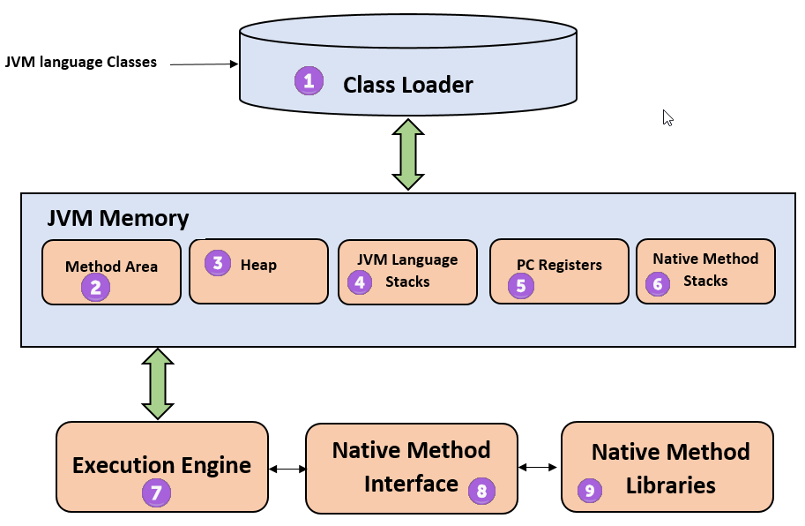
Internal Architecture of JVM:
Let's understand the internal architecture of JVM. It contains class loader, memory area, execution engine etc.
1) Class Loader
The class loader is a subsystem used for loading class files. It performs three major functions viz. Loading, Linking, and Initialization.
2) Method Area
JVM Method Area stores class structures like metadata, the constant runtime pool, and the code for methods.

Slide 7
Internal Architecture of JVM:
3) Heap
All the Objects, their related instance variables, and arrays are stored in the heap. This memory is common and shared across multiple threads.
4) JVM language Stacks
Java language Stacks store local variables, and it’s partial results. Each thread has its own JVM stack, created simultaneously as the thread is created. A new frame is created whenever a method is invoked, and it is deleted when method invocation process is complete.
5) PC Registers
PC register store the address of the Java virtual machine instruction which is currently executing. In Java, each thread has its separate PC register.
6) Native Method Stacks
Native method stacks hold the instruction of native code depends on the native library. It is written in another language instead of Java.
7) Execution Engine
It is a type of software used to test hardware, software, or complete systems. The test execution engine never carries any information about the tested product.
8) Native Method interface
The Native Method Interface is a programming framework. It allows Java code which is running in a JVM to call by libraries and native applications.
9) Native Method Libraries
Native Libraries is a collection of the Native Libraries(C, C++) which are needed by the Execution Engine.

Slide 8
Data types in JAVA
There are two data types available in Java −
Primitive Data Types
Reference/Object Data Types
There are eight primitive data types in Java:
Data Type | Size | Description
byte | 1 byte | Stores whole numbers from -128 to 127
short | 2 bytes | Stores whole numbers from -32,768 to 32,767
int | 4 bytes | Stores whole numbers from -2,147,483,648 to 2,147,483,647
long | 8 bytes | Stores whole numbers from -9,223,372,036,854,775,808 to 9,223,372,036,854,775,807
float | 4 bytes | Stores fractional numbers. Sufficient for storing 6 to 7 decimal digits
double | 8 bytes | Stores fractional numbers. Sufficient for storing 15 decimal digits
boolean | 1 bit | Stores true or false values
char | 2 bytes | Stores a single character/letter or ASCII values

Slide 9
Reference Data types:
Reference variables are created using defined constructors of the classes. They are used to access objects. These variables are declared to be of a specific type that cannot be changed. For example, Employee, Puppy, etc.
Class objects and various type of array variables come under reference datatype.
Default value of any reference variable is null.
A reference variable can be used to refer any object of the declared type or any compatible type.
Example: Animal animal = new Animal("giraffe");

Slide 10
Different types of Variables:
A variable provides us with named storage that our programs can manipulate. Each variable in Java has a specific type, which determines the size and layout of the variable's memory; the range of values that can be stored within that memory; and the set of operations that can be applied to the variable.
Local variables
Instance variables
Class/Static variables

Slide 11
Local Variables:
Local variables are declared in methods, constructors, or blocks.
Local variables are created when the method, constructor or block is entered and the variable will be destroyed once it exits the method, constructor, or block.
Access modifiers cannot be used for local variables.
Local variables are visible only within the declared method, constructor, or block.
Local variables are implemented at stack level internally.
There is no default value for local variables, so local variables should be declared and an initial value should be assigned before the first use.

Slide 12
Instance variables
Instance variables are non-static variables and are declared in a class outside any method, constructor or block. As instance variables are declared in a class, these variables are created when an object of the class is created and destroyed when the object is destroyed.
Unlike local variables, we may use access specifiers for instance variables. If we do not specify any access specifier then the default access specifier will be used.
Initialization of Instance Variable is not Mandatory. Its default value is 0
Instance Variable can be accessed only by creating objects.

Slide 13
Static Variables:
Class variables also known as static variables are declared with the static keyword in a class, but outside a method, constructor or a block.
There would only be one copy of each class variable per class, regardless of how many objects are created from it.
Static variables are rarely used other than being declared as constants. Constants are variables that are declared as public/private, final, and static. Constant variables never change from their initial value.

Slide 14
Thank You

Slide 15


